Slide 1
April 8, 2022 Warfield Blvd

Slide 2
Submission To Civil Authority

Slide 3
Psalm 33:12
Blessed is the nation whose God is the Lord, the people whom he has chosen as his heritage!

Slide 4
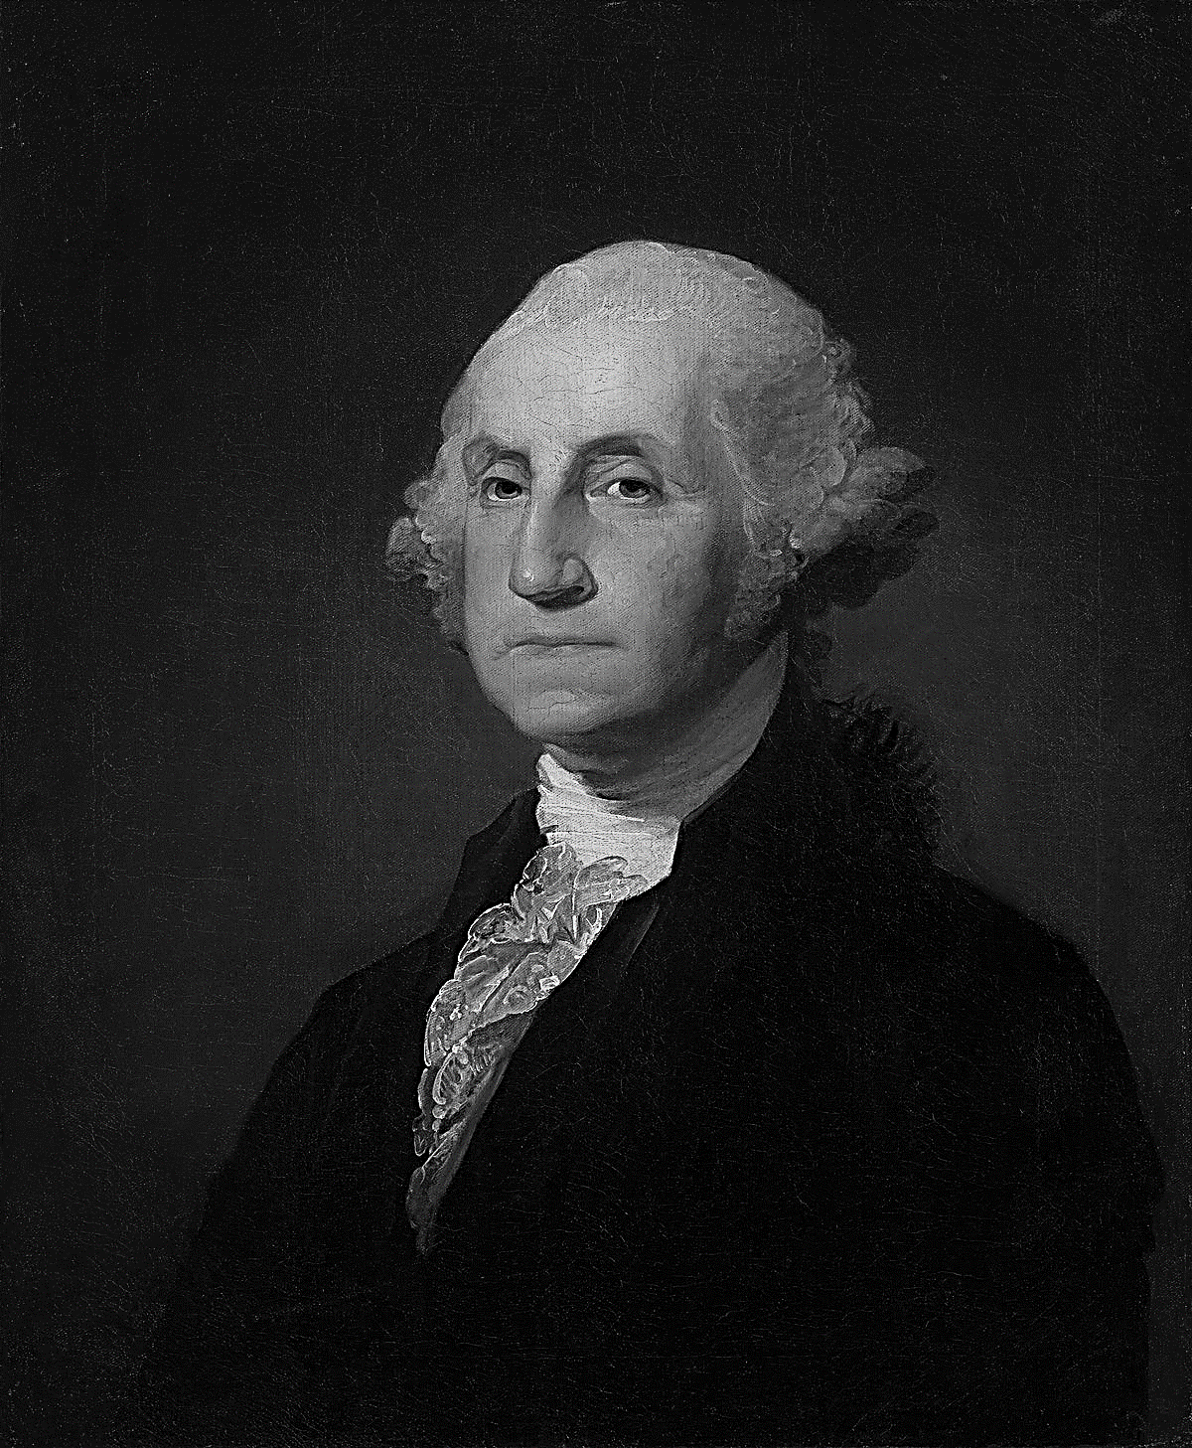
It is Impossible to rightly govern a nation without God and the Bible.
- George Washington

Slide 5
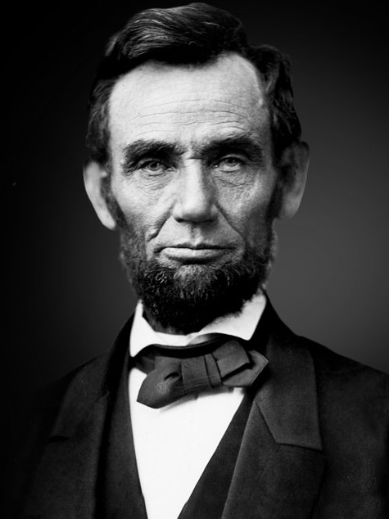
And whereas it is the duty of nations as well as of men, to own their dependence upon the overruling power of God ... and to recognize the sublime truth, announced in the Holy Scriptures and proven by all history, that those nations only are blessed whose God is the Lord.
- Abraham Lincoln

Slide 6
Submission:
The action or fact of accepting or yielding to a superior force or to the will or authority of another person.
Humble compliance, conformity, obedience, subordination.
To surrender

Slide 7
Submission Is Not:
Contrariness, defiance, disobedience, insubordination, noncompliance, rebellion, rebelliousness, self-will, unruliness, waywardness, willfulness.

Slide 8
Romans 13:1-7
1 Let every soul be subject to the governing authorities. For there is no authority except from God, and the authorities that exist are appointed by God.
2 Therefore whoever resists the authority resists the ordinance of God, and those who resist will bring judgment on themselves.

Slide 9
3 For rulers are not a terror to good works, but to evil. Do you want to be unafraid of the authority? Do what is good, and you will have praise from the same.
4 For he is God’s minister to you for good. But if you do evil, be afraid; for he does not bear the sword in vain; for he is God’s minister, an avenger to execute wrath on him who practices evil.

Slide 10
5 Therefore you must be subject, not only because of wrath but also for conscience’ sake.
6 For because of this you also pay taxes, for they are God’s ministers attending continually to this very thing.
7 Render therefore to all their due: taxes to whom taxes are due, customs to whom customs, fear to whom fear, honor to whom honor.

Slide 11
Is Government By Man’s Design?
God instituted Deut 1:13; 16:18-20
Men reject God 1 Sam 8:7; 2 Tim 3:1-5
Nations temporary Job 12:23; 1 Cor 15:24
A spiritual purpose Eph 6:12

Slide 12
What Is The Godly View of Civil Authority?
Authority from God 1 Pt 2:13-14; Jn 19:11
Not above God Acts 5:29
Focus on good Titus 3:1; Dan 2:21
Never compromise Dan 1:8-9; Gal 2:11-13
Accept good & bad Acts 5; Prov 29:2
For our protection Rom 13:4
Live to serve God John 4:20

Slide 13
How Do Christians Show Submission To Government?
1. Be productive 2 Thess 3:10-12
2. Be involved Rom 12:18-21
3. Respect the office 1 Sam 24-26
4. Pay taxes Mt 22:17-21; 17:24-17

Slide 14
Human Reasoning from Matthew 22:17-21…..
(He’s not my leader!) “Tell us, then, what you think. Is it lawful to pay taxes to Caesar, or not?”
(It’s my money!) “But Jesus, aware of their malice, said, “Why put me to the test, you hypocrites? Show me the coin for the tax.” And they brought him a denarius.” “And Jesus said to them, “Whose likeness and inscription is this?” They said, “Caesar's.” Then he said to them, “Therefore render to Caesar the things that are Caesar's, and to God the things that are God's.”

Slide 15
How Do Christians Show Submission To Government?
1. Be productive 2 Thess 3:10-12
2. Be involved Rom 12:18-21
3. Respect the office 1 Sam 24-26
4. Pay taxes Mt 22:17-21; 17:24-17
5. Obey laws Rom 13:1

Slide 16
How Do Christians Show Submission To Government?
1. Be productive 2 Thess 3:10-12
2. Be involved Rom 12:18-21
3. Respect the office 1 Sam 24-26
4. Pay taxes Mt 22:17-21; 17:24-17
5. Obey laws Rom 13:1
6. In civil matters Lev 19:15; Mat 5:25; 1 Cor 6:1-4; Lk 12:57-59

Slide 17
Is There A Time When Christians Should Not Submit To Government?
When Christ is opposed Acts 5:17- 42
When man is worshipped Daniel 3
When worship is forbidden Daniel 6
Accept consequences Acts 5; Lk 12

Slide 18
How Can Christians Use Civil Authority to Our Advantage?
Rights to religion

Slide 19
The First Amendment to the U.S. Constitution states:
“Congress shall make no law respecting an establishment of religion, or prohibiting the free exercise thereof; or abridging the freedom of speech, or of the press; or the right of the people peaceably to assemble”

Slide 20
How Can Christians Use Civil Authority to Our Advantage?
Rights to religion
Use civil resources Acts 22

Slide 21
U.S. Equal Employment Opportunity Commission says….
Under Title VII of the Civil Rights Act of 1964, Religious discrimination involves treating a person (an applicant or employee) unfavorably because of his or her religious beliefs. The law protects not only people who belong to traditional, organized religions, such as Buddhism, Christianity, Hinduism, Islam, and Judaism, but also others who have sincerely held religious, ethical or moral beliefs.

Slide 22
How will God change the current state of our government?
By protest? Pro 31:9; 29:7-8
By the voice of His people 1 Sam 8:7
By our wants and will or His Rom 8:28
By the prayers of His people 1 Tim 2:1-3
By His purpose for good Gen 50:20
By the good of His people Jeremiah 29:7

Slide 23
We are persuaded that good Christians will always be good citizens, and that where righteousness prevails among individuals the Nation will be great and happy. Thus while just government protects all in their religious rights, true religion affords to government it's surest support.
- George Washington

Slide 24
We cannot be complaining, hateful and disrespectful to the authorities in our lives then walk into a church building and talk about how much we love the Lord. (1 John 4:20)

